Slide 1

VA Data Analysis
Derya Ferendeci
Jasmine Williamson
Megan Payich

Slide 2



VA Data Explanation
Data Preparation
ETL
ER Diagram
Machine Learning
Dashboard

Slide 3




Introduction
We selected this topic because the Veteran population and VA benefits are always a talking point for legislators.
It will be interesting to break down the data, look at some trends and predict what the future can look like for Veterans and their benefits within VA Healthcare.
Specifically, we are going to use the following to predict each hospital performance: expenditures, unique patient data, patient experience and employee satisfaction .

Slide 4

VA DATA

Slide 5
Each fiscal year the Department of Veterans Affairs’ Office of Policy and Planning publishes the annual Geographic Distribution of VA Expenditures (GDX) Report for the public and all stakeholders.
The GDX Report also includes Veteran population estimates at the:
State
County
Congressional District
Number of unique patients who used VA health care services
Expenditure data are grouped by the following categories:
Compensation and Pension
Education and Vocational Rehabilitation and Employment
Insurance and Indemnities
Construction and Related Costs
General Operating Expenses and Related Costs
Loan Guaranty
Medical Expenditures

Slide 6
SAIL or Strategic Analytics for Improvement and Learning Value Model:
It is a system for summarizing hospital system performance within Veterans Health Administration (VHA)
SAIL assesses Key Quality Measures at individual VA Medical Centers (VAMCs) in areas such as:
Death rate
Complications
Patient satisfaction
Overall efficiency
Each VA medical center is given an Efficiency score 0-100
We used XGBRegressor to predict the efficiency score (0-100) of a VA medical center based on factors such as:
Expenditures
Unique Patient Data
Patient Experience
Employee Satisfaction

Slide 7
DATA PREPARATION

Slide 8
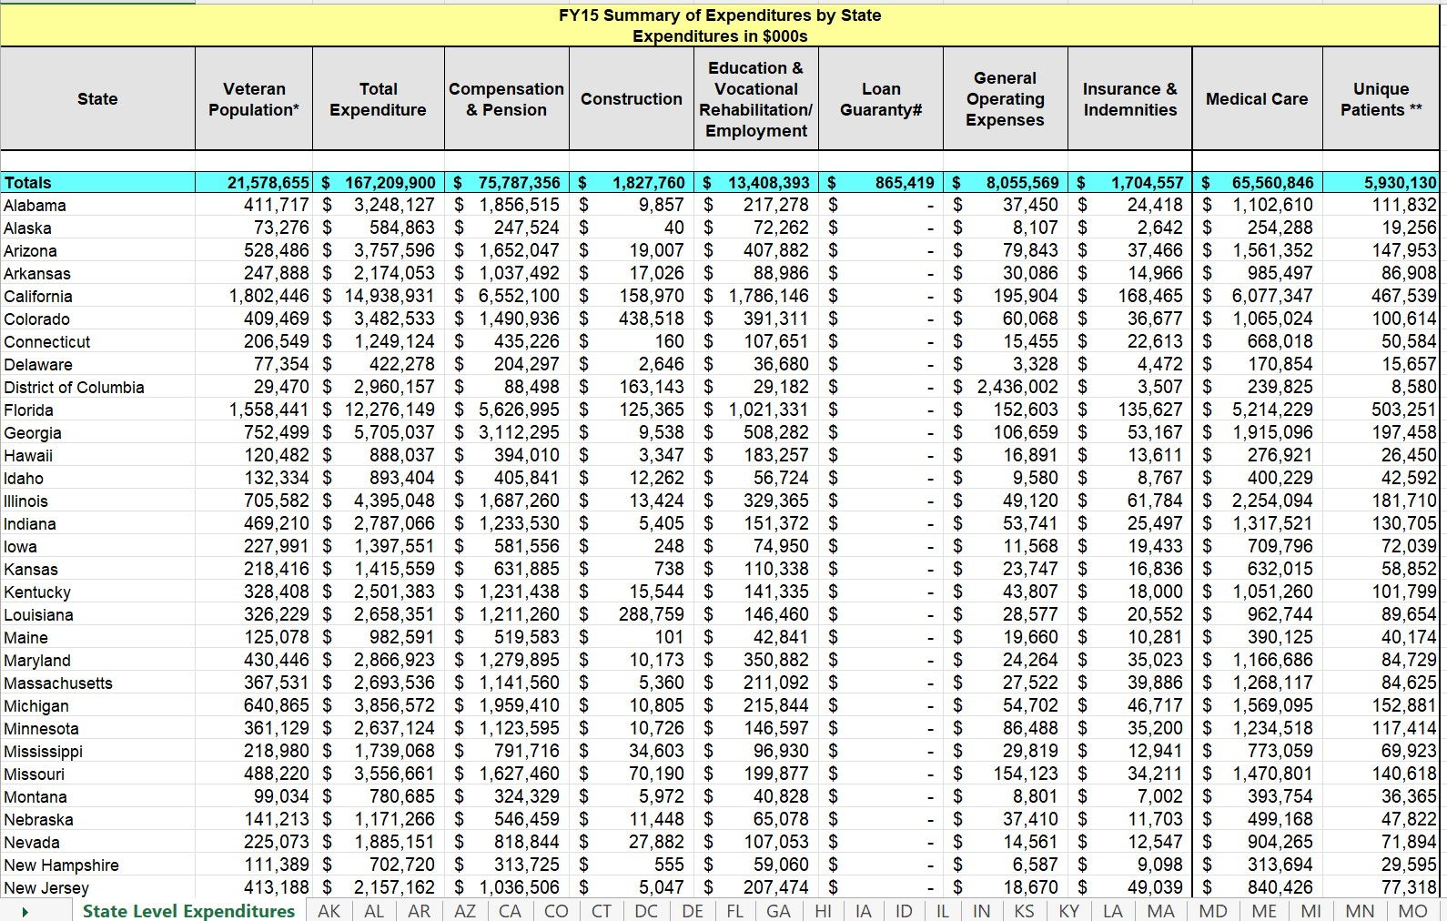
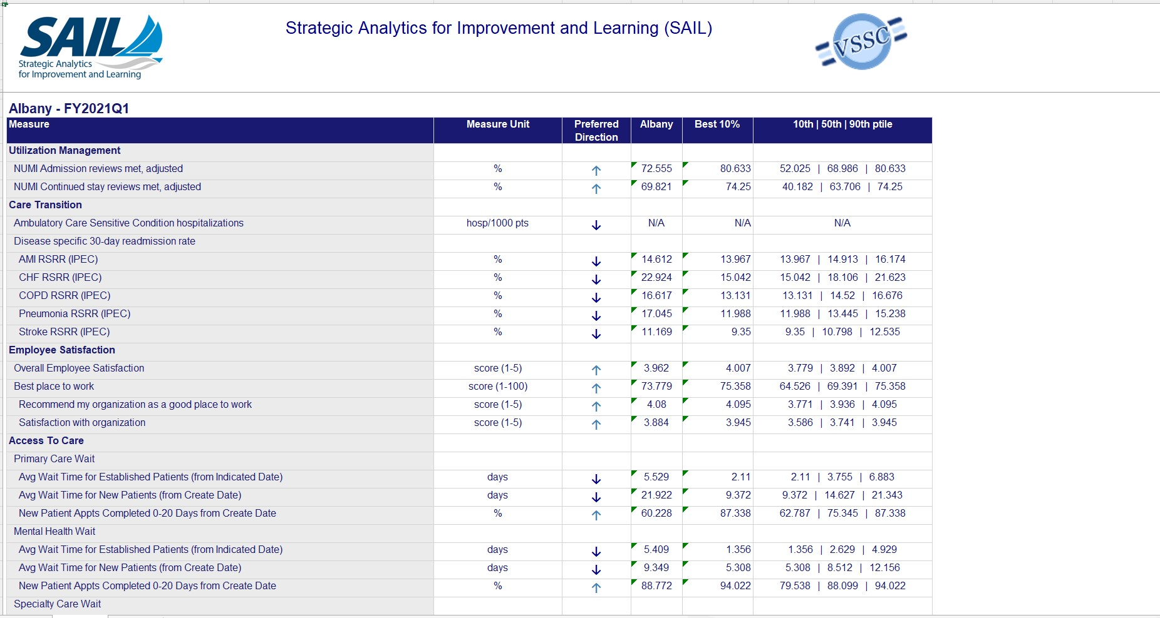
GDX Report SAIL Data

Slide 9
ETL

Slide 10
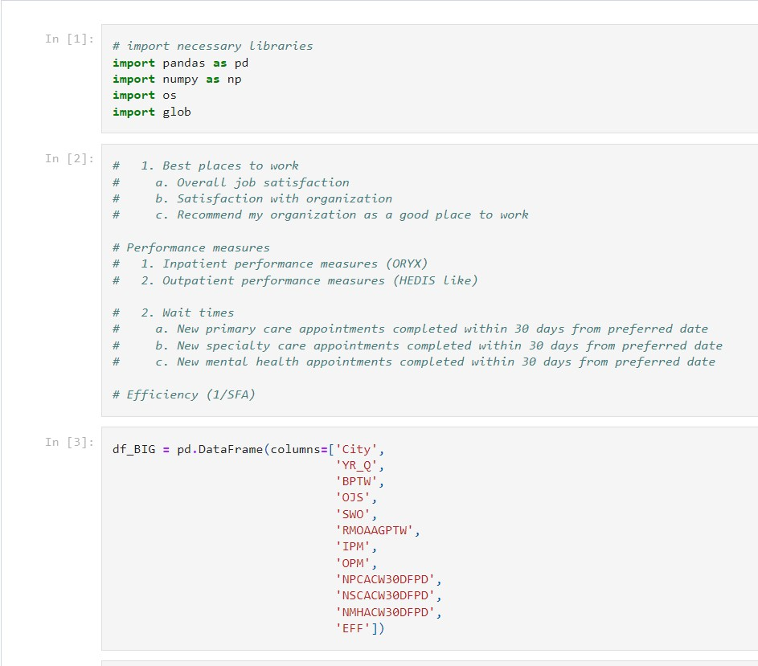
SAIL data extracted into Quality.csv using Jupyter Notebook.

Slide 11
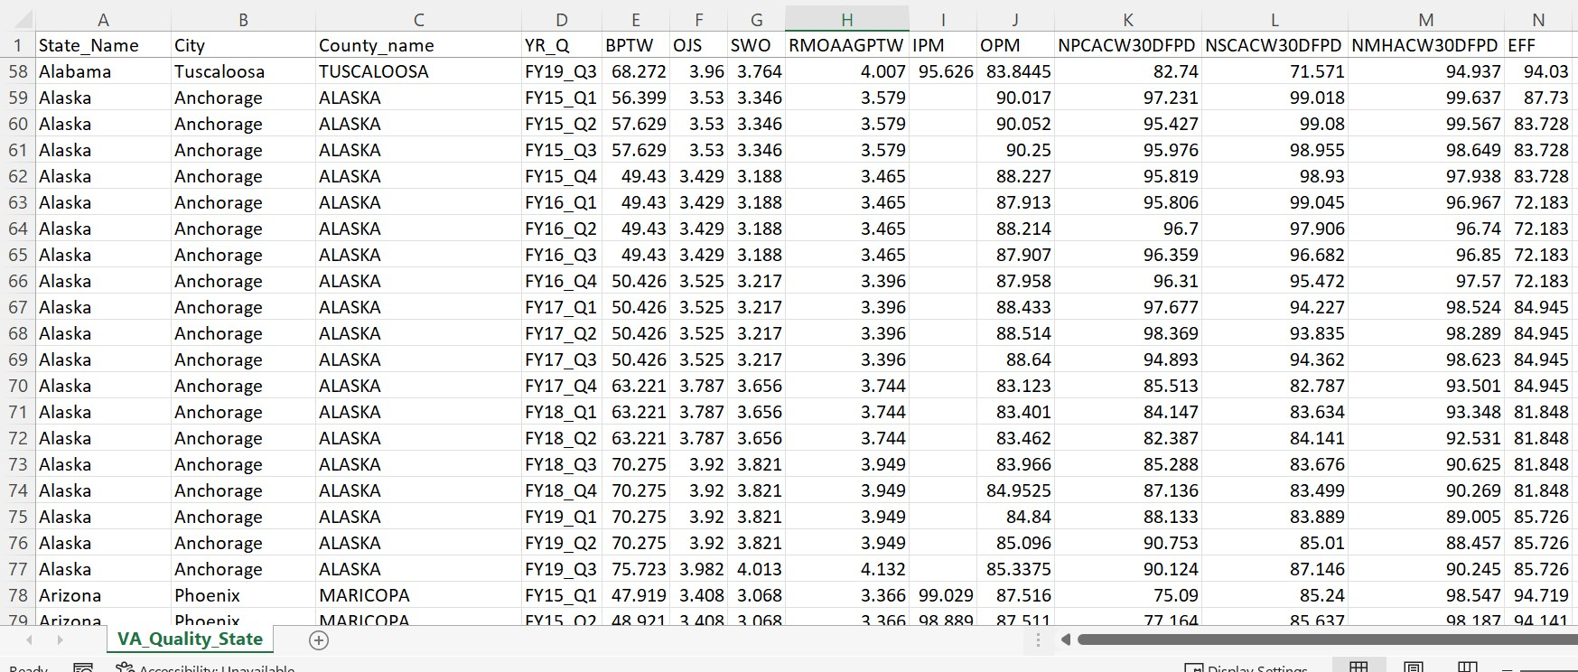
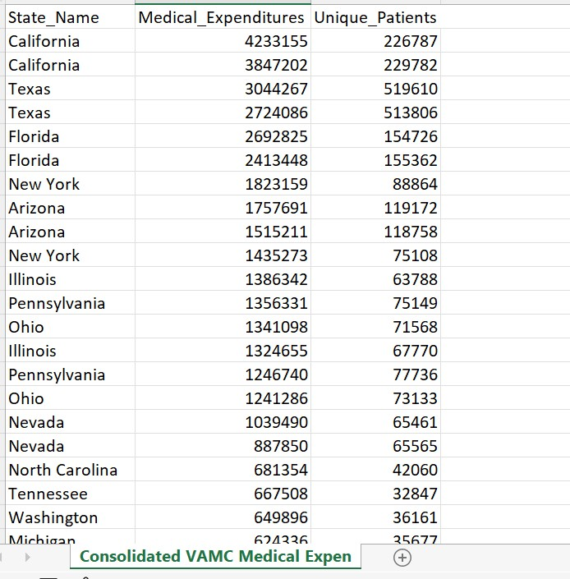
CSVs

Slide 12
ER DIAGRAM

Slide 13
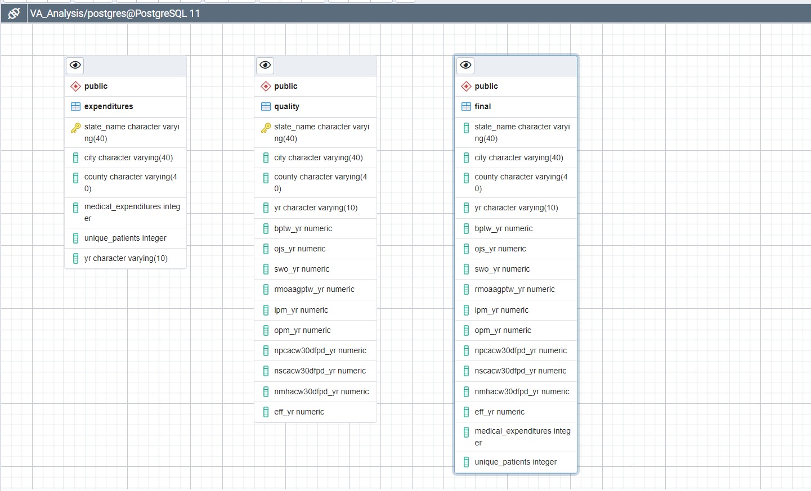
ER DIAGRAM

Slide 14
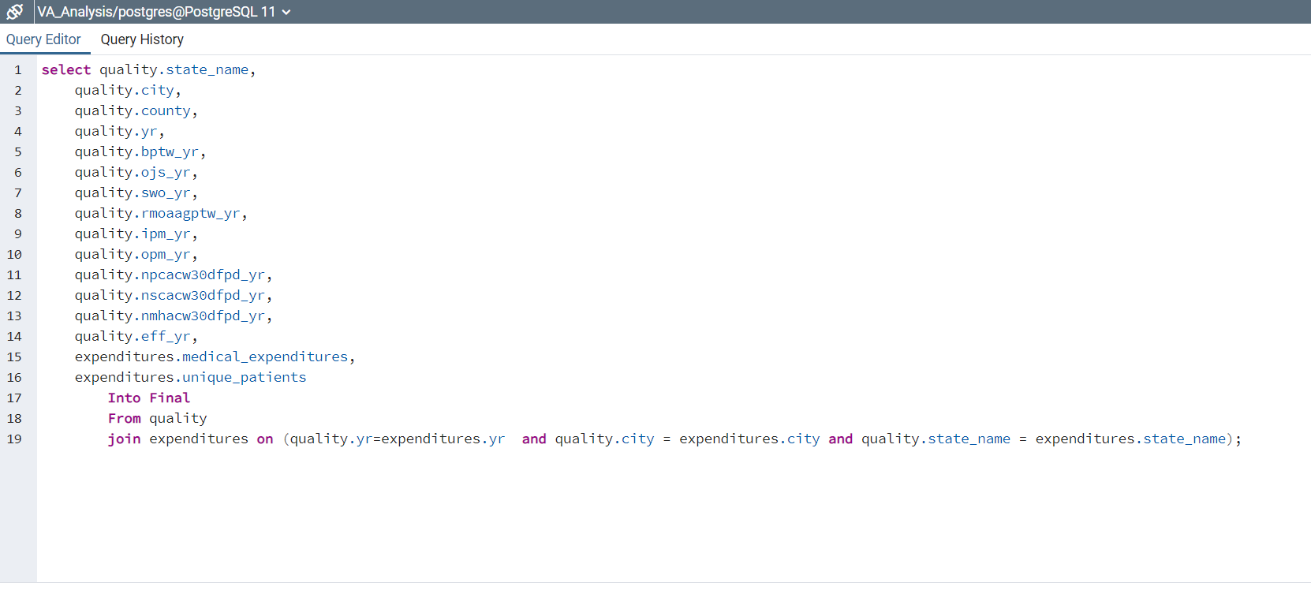
Joined Quality and Expenditures on Year, City, and State Name to get Final Dataset for model

Slide 15
MACHINE LEARNING

Slide 16
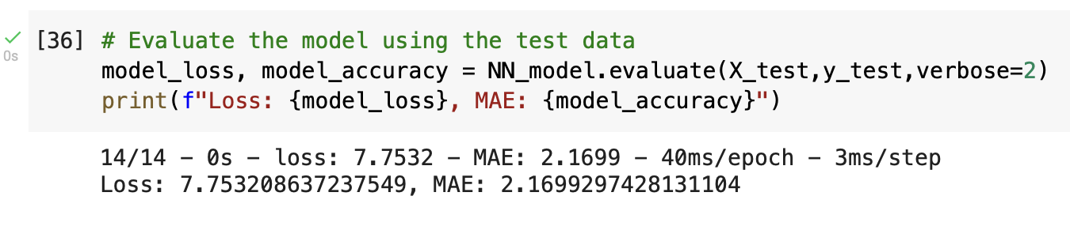
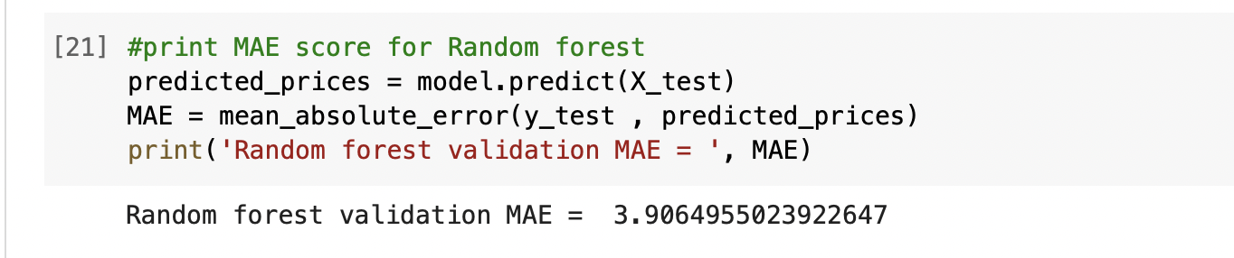
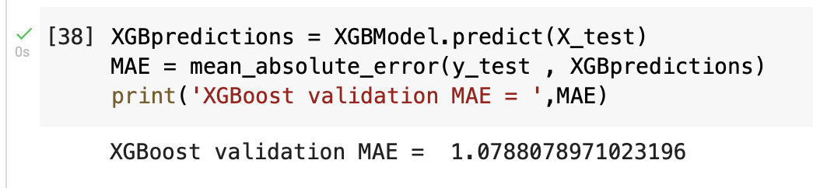
Machine Learning Model

Slide 17
We load and processed the dataset
We got familiar with the dataset by plotting some histograms and a correlation heat map of the features
We used a deep neural network with three hidden layers each one has 256 nodes.
We used relu activation function on the output layer
We trained the model then tested it.
We also tested two other models: XGBRegressor and Random Forest Regressor
Our XGBRegressor was able to outscore the other two models

Slide 18
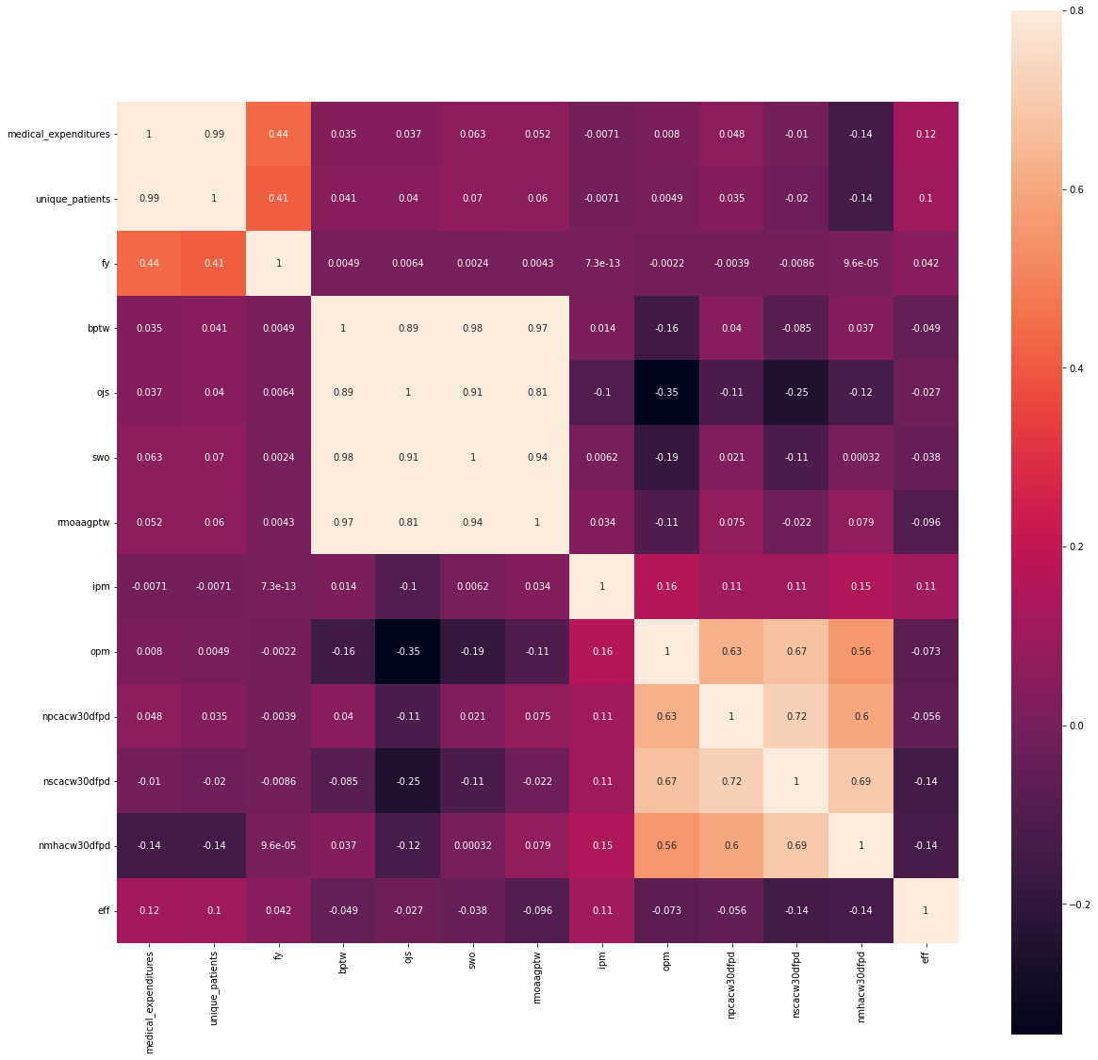

Slide 19
DASHBOARD

Slide 20
VA_Quality_Final_with_Predictions | Tableau Public

Slide 21


LESSONS LEARNED

Slide 22
QUESTIONS

Slide 23
Thank You

